Slide 1
CSE 601: Distributed Systems
Toukir Ahammed

Slide 2
Architectural Styles

Slide 3
Architectural Styles
Important styles of architecture for distributed systems:
Layered architectures
Object-based architectures
Data-centered architectures
Event-based architectures

Slide 4
Architectural Styles
Resource-based Architectures

Slide 5
Resource-based Architectures
View a distributed system as a huge collection of resources that are individually managed by components
Resources may be added or removed by (remote) applications, and likewise can be retrieved or modified
This approach has now been widely adopted for the Web and is known as Representational State Transfer (REST)
REST is an architectural style based on transferring representations of resources from a server to a client

Slide 6
Resource-based Architectures
There are four key characteristics of RESTful architectures:
Resources are identified through a single naming scheme
All services offer the same interface, consisting of at most four operations
Messages sent to or from a service are fully self-described
After executing an operation at a service, that component forgets everything about the caller (stateless execution)

Slide 7
Resource-based Architectures
Basic Operations
Operation | Description
PUT | Create a new resource
GET | Retrieve the state of a resource in some representation
DELETE | Delete a resource
POST | Modify a resource by transferring a new state

Slide 8
Resource-based Architectures
Basic Operations

Slide 9
Resource-based Architectures
Example: Amazon’s Simple Storage Service (Amazon S3)
Objects (i.e., files) are placed into buckets (i.e., directories)
Buckets cannot be placed into buckets
Operations on ObjectName in bucket BucketName require the following identifier: https://s3.amazonaws.com/BucketName/ObjectName
Typical operations
All operations are carried out by sending HTTP requests:
Create a bucket/object: POST, along with the URI
Listing objects: GET on a bucket name
Reading an object: GET on a full URI

Slide 10
Architectural Styles
Event based architectures

Slide 11
Event based Architectures
As systems continue to grow and processes can more easily join or leave, it becomes important to have an architecture in which dependencies between processes become as loose as possible
An architecture is needed in which there is a strong separation between processing and coordination
Coordination can be discussed from two dimensions: temporal and referential.

Slide 12
Event based Architectures
Temporal coupling means that processes that are communicating will both have to be up and running.
Referential coupling generally appears in the form of explicit referencing in communication.
For example, a process can communicate only if it knows the name or identifier of the other processes it wants to exchange information with.

Slide 13
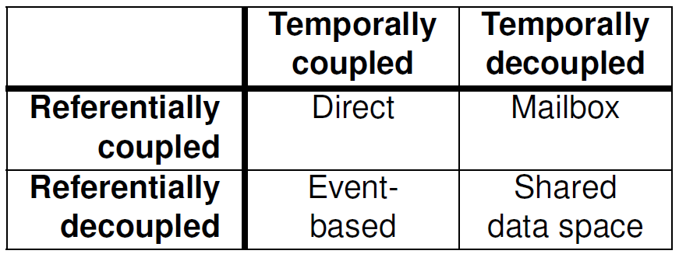
Event based Architectures

Slide 14
Event based Architectures
Direct coordination: when processes are temporally and referentially coupled, coordination takes place directly.
In real life, talking over cell phones (and assuming that a cell phone has only one owner), is an example of direct communication.
Mailbox coordination: when processes are temporally decoupled, but referentially coupled
there is no need for two communicating processes to be active at the same time to let communication take place.
Instead, communication takes place by putting messages in a (possibly shared) mailbox

Slide 15
Event based Architectures
Event-based coordination: The combination of referentially decoupled and temporally coupled systems
processes do not know each other explicitly
a process publish a notification describing the occurrence of an event
processes may subscribe to a specific kind of notification
it is generally required that the subscriber is up-and-running at the time the
notification was published

Slide 16
Event based Architectures
Shared data space: the combination of referentially and temporally decoupled processes
The key idea is that processes communicate entirely through tuples, which are structured data records consisting of several fields, very similar to a row in a database table
Processes can put any type of tuple into the shared data space.
To retrieve a tuple, a process provides a search pattern that is matched against the tuples. Any tuple that matches is returned
A process subscribes to certain tuples by providing a search pattern; when a process inserts a tuple into the data space, matching subscribers are notified

Slide 17
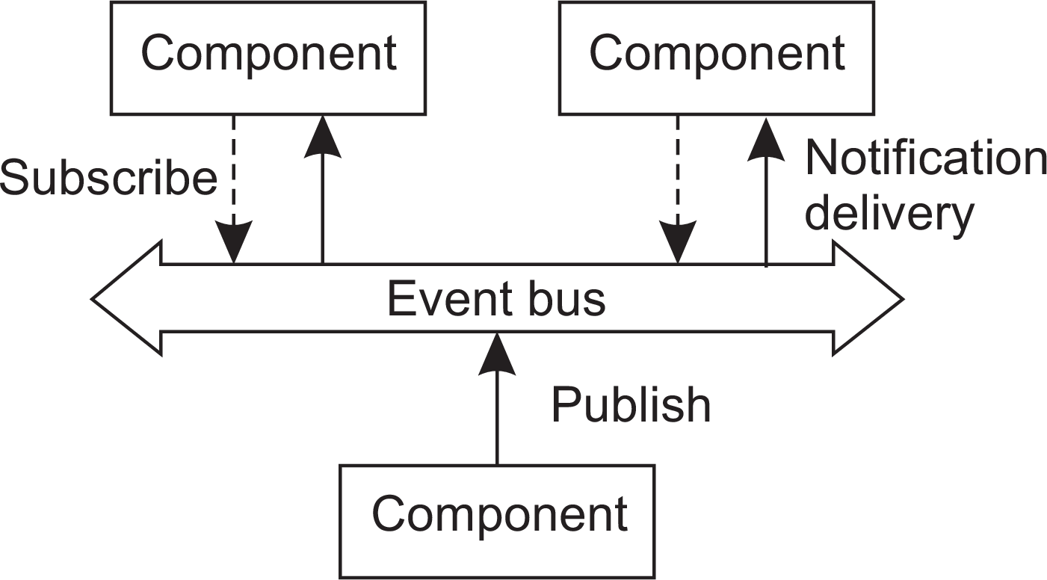
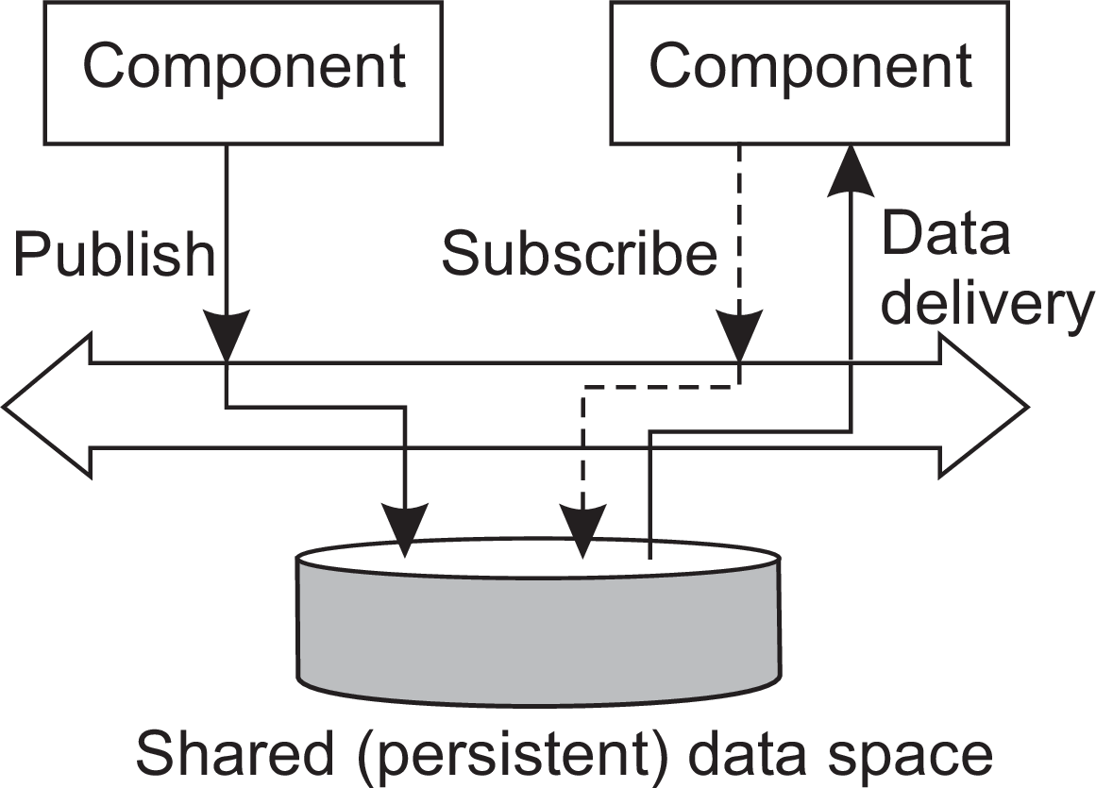
Publish-subscribe architectures

